Slide 1

Financial Management
Team Members & Roll Numbers
Janamjay Gupta
Sayan Manna
Ganesh S
Roll No. 25BAI11262
Roll No. 25BAI10467
Roll No. 25MEI10020
Vidit Agarwal
Rochan R K
Roll No. 25BCY10049
Roll No. 25BCE11177

Slide 2

The Problem We're Solving
The Challenge
Our Solution
Most people struggle to track where their money goes each month. Without visibility into spending patterns, budgeting becomes guesswork and overspending happens easily.
A simple app that records every expense, organizes it by category, and shows you exactly how much you're spending on food, entertainment, transportation, and more—all in one place.

Slide 3
Challenges We Overcame
Database Synchronization
Category Logic
Issue: Data wasn't saving properly when the app closed. Solution: Implemented proper SQLite connection management and auto-commit functions.
Issue: Some expenses didn't fit standard categories. Solution: Added custom category feature allowing users to create personalized categories.
Team Coordination
Error Handling
Issue: Different team members working on separate modules independently. Solution: Established weekly sync-ups and shared code documentation.
Issue: Invalid inputs crashed the app. Solution: Added validation checks and user-friendly error messages.

Slide 4

Technologies & Architecture
Programming Stack
System Architecture
Language: Python with Object-Oriented Design
Input Module: Form-based expense entry
Database: SQLite for local data storage
Storage Module: SQLite database management
Interface: GUI with Tkinter (Desktop App)
Report Module: Data analysis and visualization
UI Module: User-friendly dashboard

Slide 5

System Design Overview
Process Flow: User enters expense → App validates data → Assigns category → Stores in database → Updates summary display → User views analytics

Slide 6
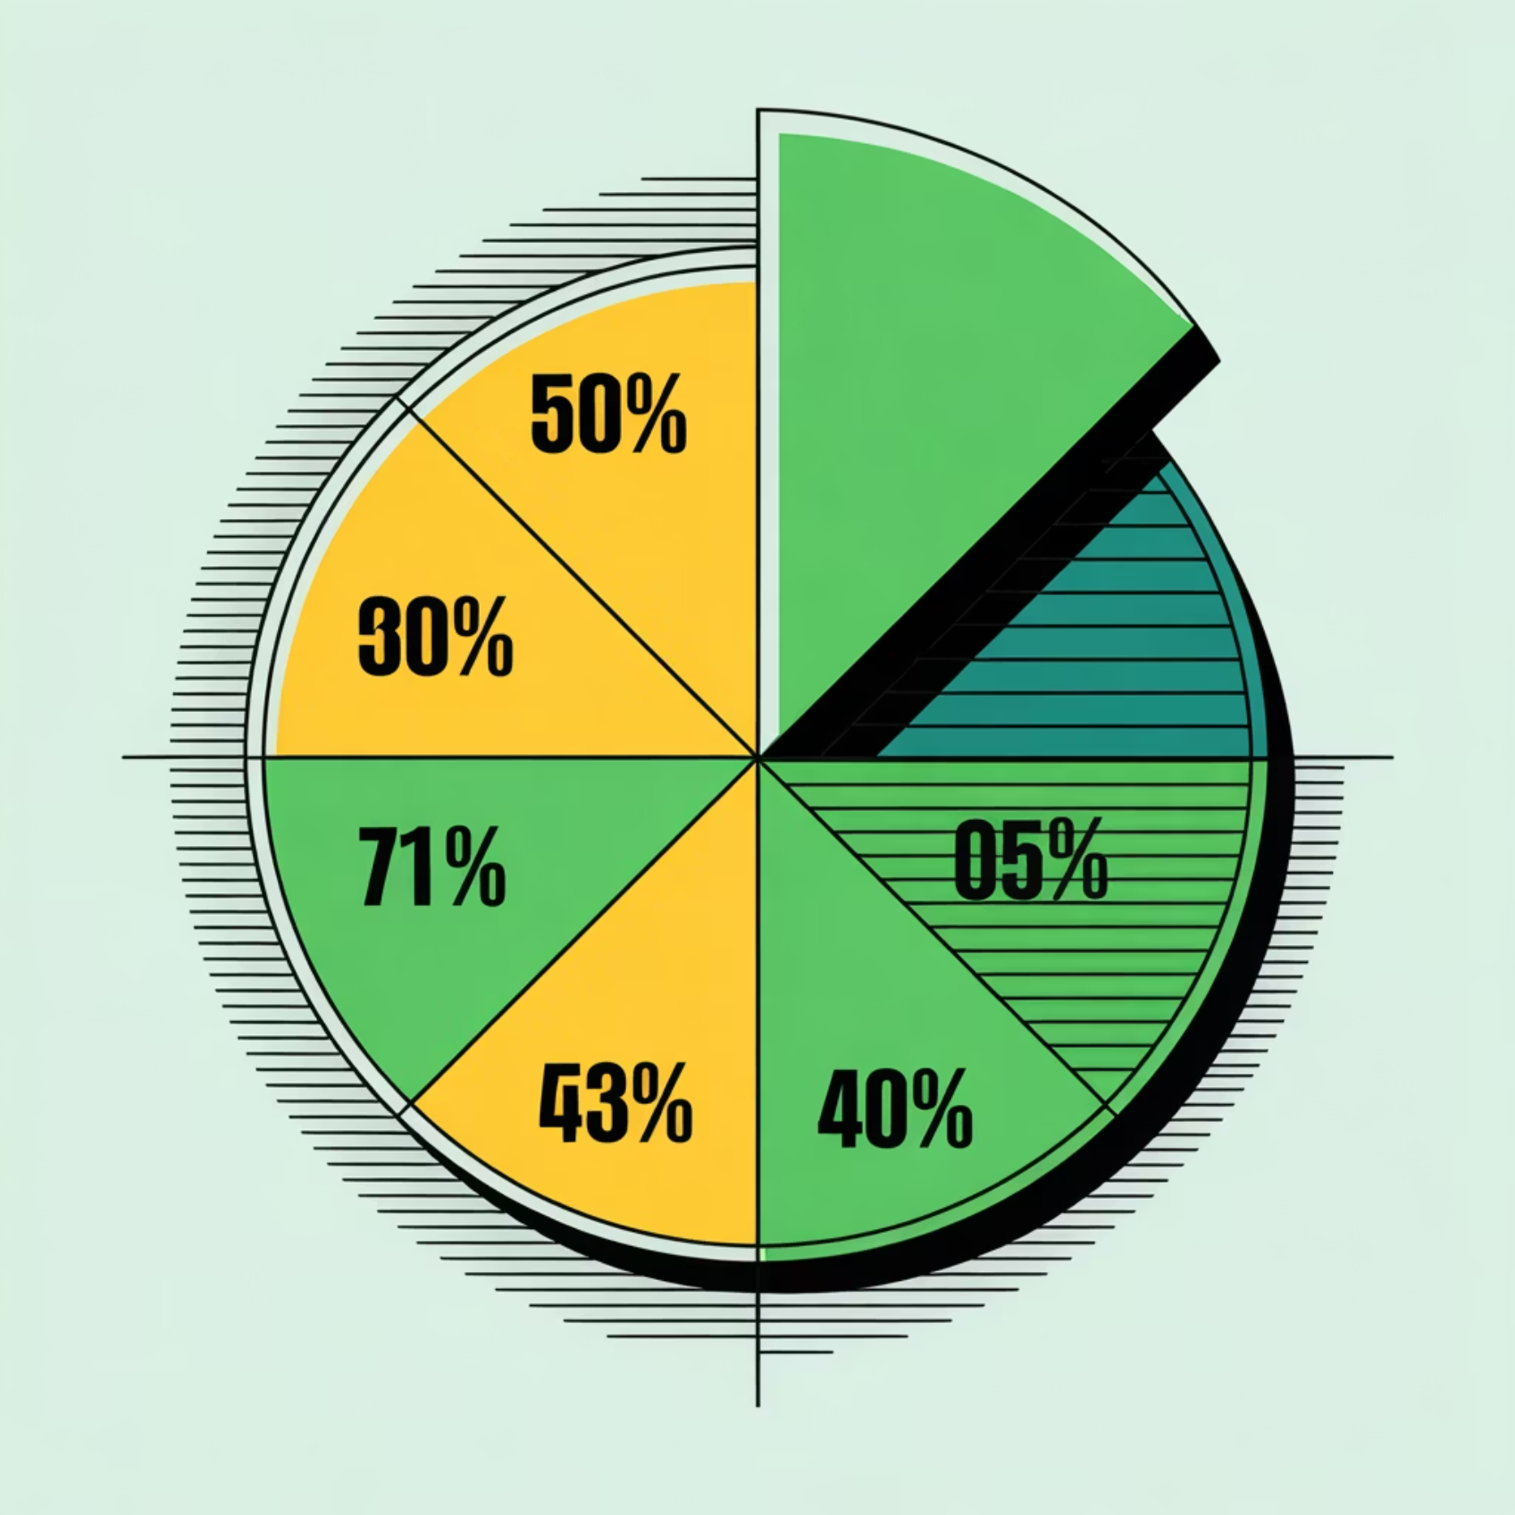
Real-World Usage Example
Scenario: Sarah's March Budget
She spent:
Food & Groceries: ₹4500
Transport: ₹1200
Entertainment: ₹850
Utilities: ₹2000
Total: 8550 this month
With our app, Sarah can see exactly where her money went and plan better for next month. She realizes entertainment spending is high and decides to cut back.

Slide 7
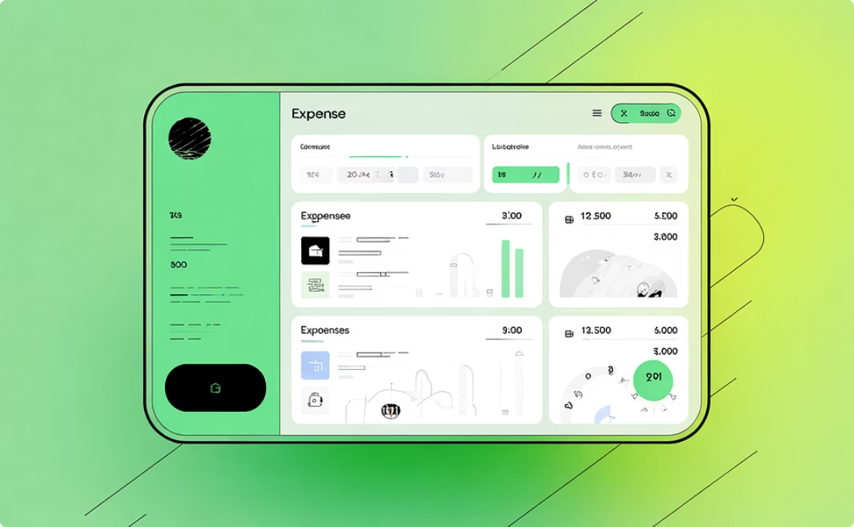

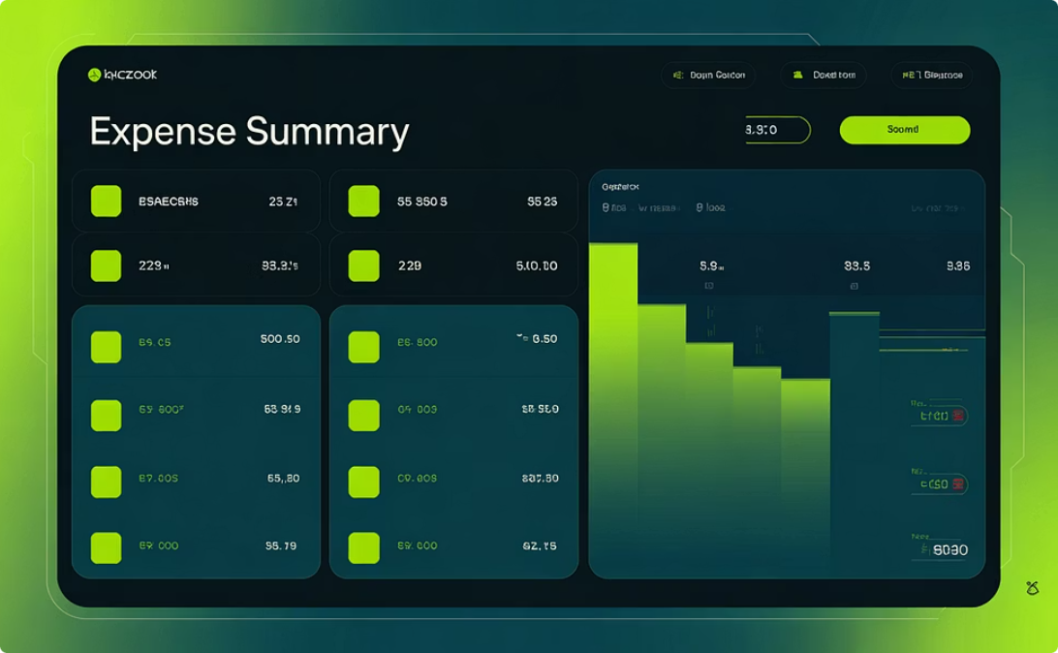
Current Progress & Working Demo
Dashboard View
Add Expense Form
Summary Reports
Live display of all recorded expenses with category tags and amounts
Working form to input new expenses with category selection
Category-wise spending breakdown with monthly totals

Slide 8

Next Steps & Future Vision
Complete Reports Module
Finish building visual charts and analytics dashboard for better expense insights
Mobile Integration
Expand to mobile platform so users can log expenses on-the-go with a smartphone app
Cloud Sync
Enable backup and sync across multiple devices for seamless expense tracking anywhere
Smart Recommendations
Add AI-powered suggestions to help users optimize spending and reach their budget goals

Slide 9

Why This App Matters
Real-Time Awareness
Smart Planning
Identify spending patterns and set realistic budgets
Know exactly where each dollar goes instantly
Financial Control
Make informed decisions and reduce unnecessary spending

Slide 10
Challenges We Overcame
Database Synchronization
Category Logic
Issue: Data wasn't saving properly when the app closed. Solution: Implemented proper SQLite connection management and auto-commit functions.
Issue: Some expenses didn't fit standard categories. Solution: Added custom category feature allowing users to create personalized categories.
Team Coordination
Error Handling
Issue: Different team members working on separate modules independently. Solution: Established weekly sync-ups and shared code documentation.
Issue: Invalid inputs crashed the app. Solution: Added validation checks and user-friendly error messages.

Slide 11
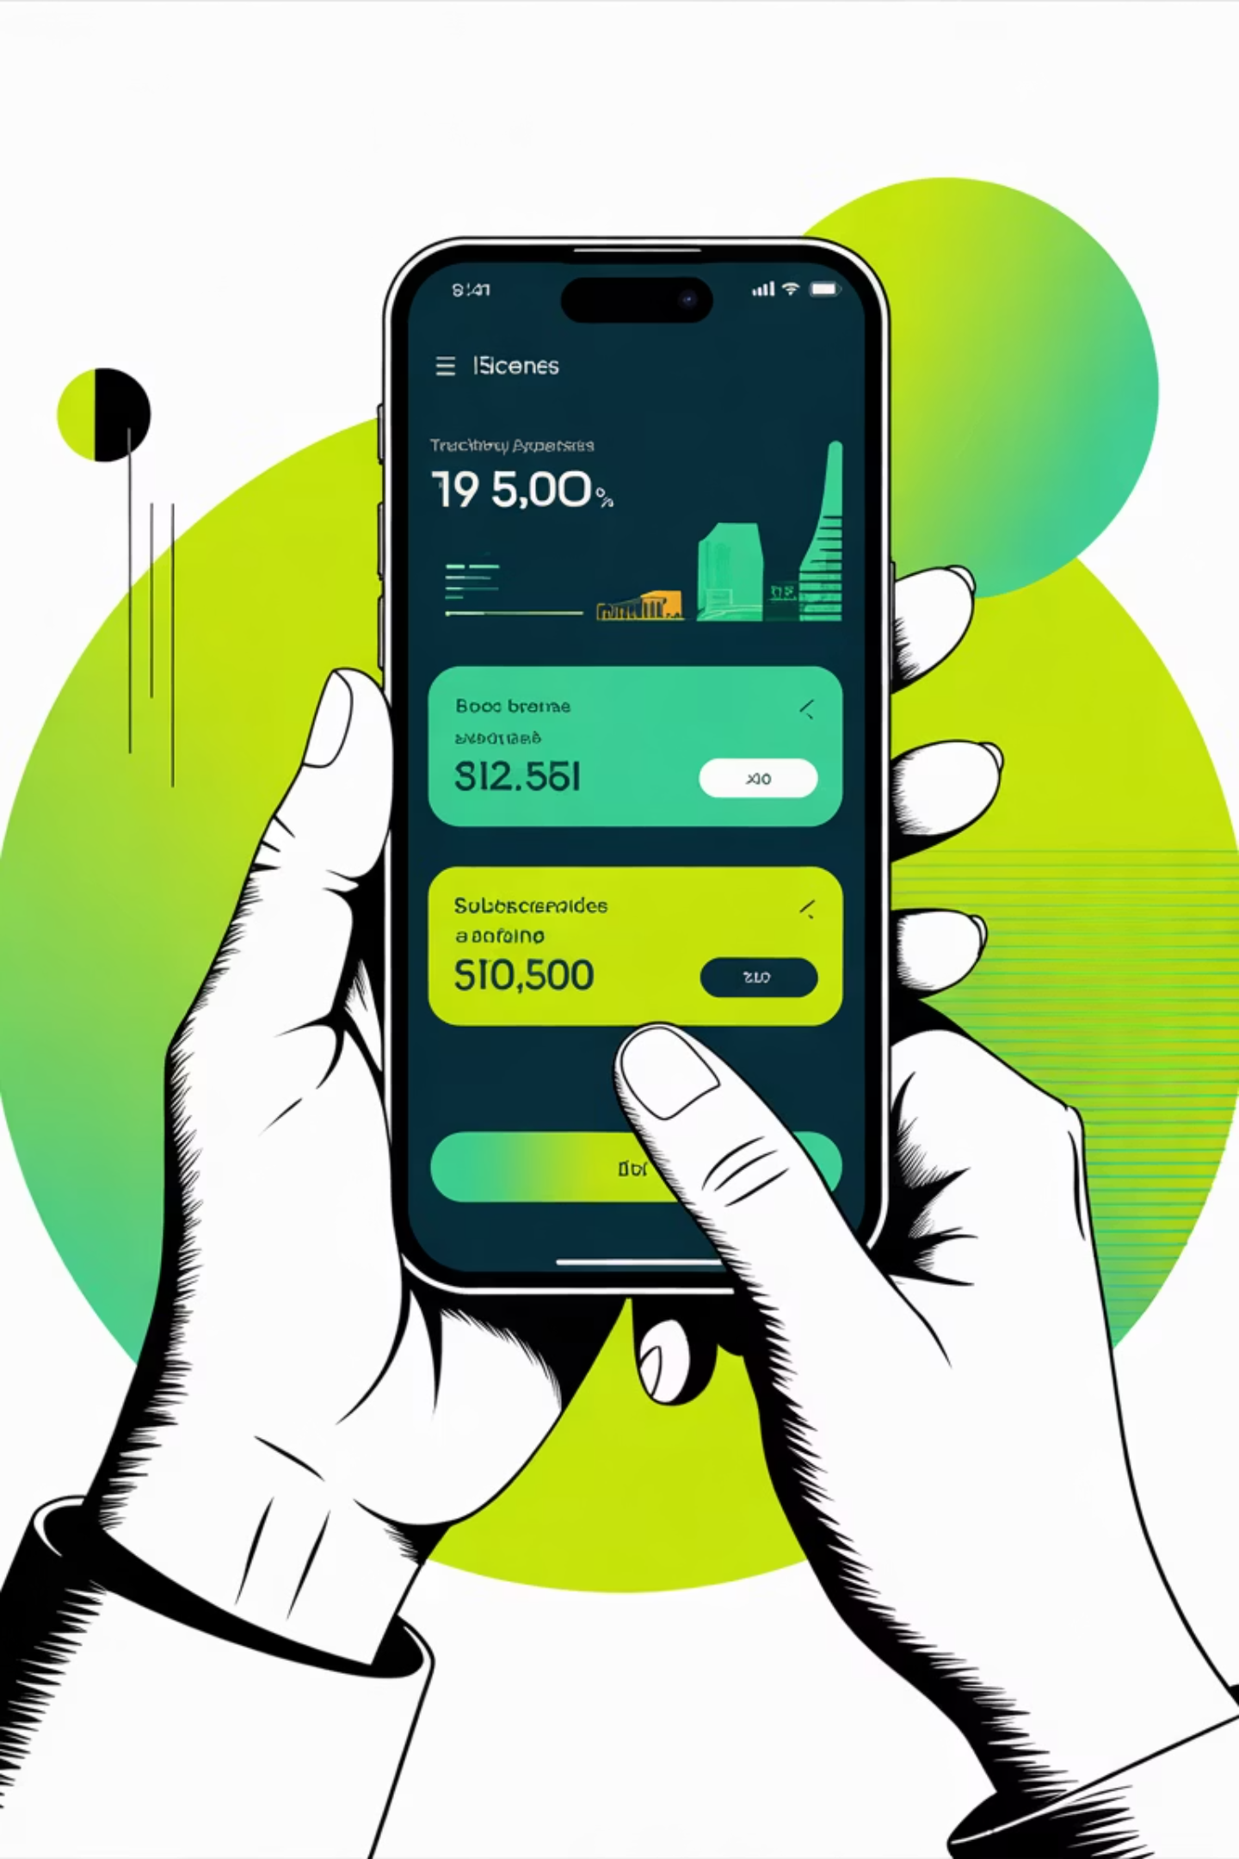
Financial Expense Management Application
A practical solution to track, organize, and understand personal spending

